Slide 1

Temporal change of biodiversity in the Anthropocene
Petr Keil
Notes:
Hi, my name is Petr Keil and this is my project Biodiversity dynamics across a continuum of space, time, and their scales.

Slide 2
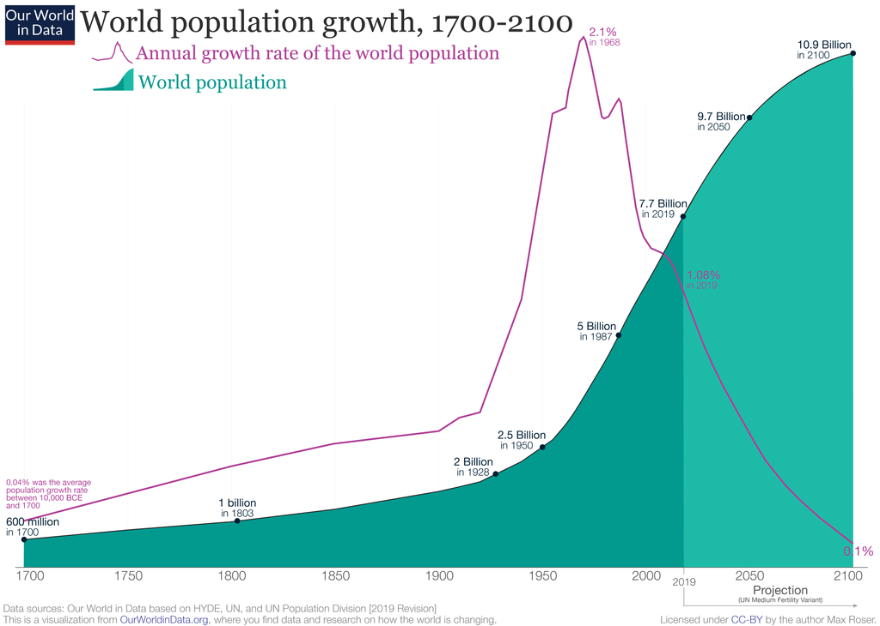
Human population trend and the Anthropocene (a.k.a. the “Age of Humans”)
Notes:
In this panel we can probably all agree that biodiversity is one of the most valuable natural resources.
But things like climate change or habitat loss are a threat to biodiversity, to the extent that we hear about biodiversity crisis, or sixth mass extinction
For example, about 1% of vertebrate species have gone extinct because of humans

Slide 3
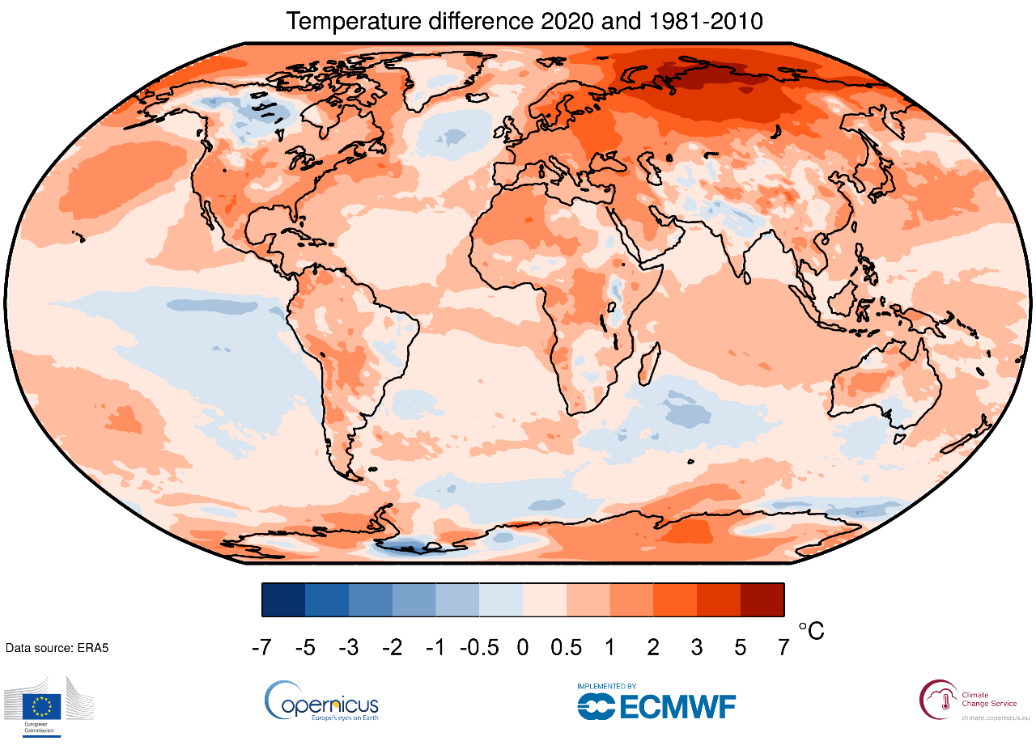
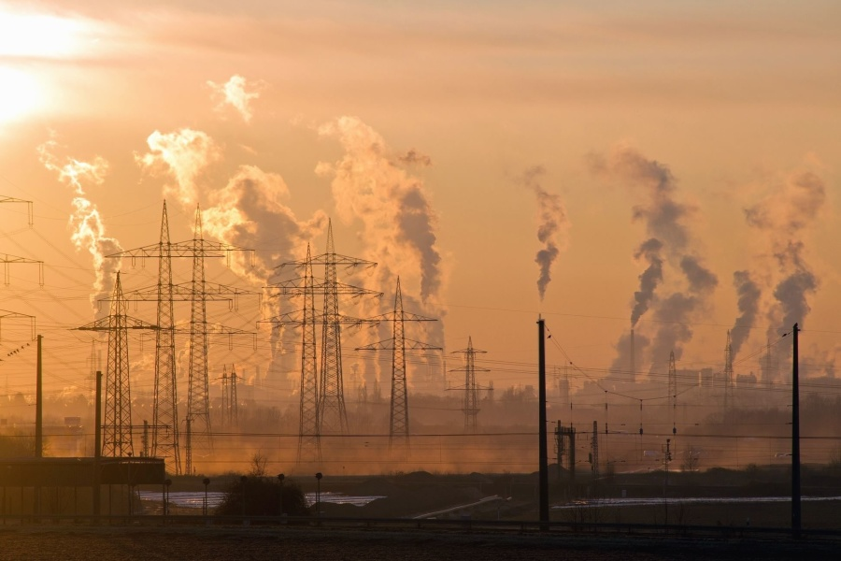
Humans are changing climate
Photo: Wikimedia Commons, Map: ERAS

Slide 4
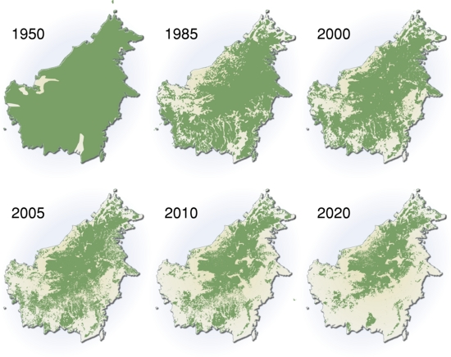
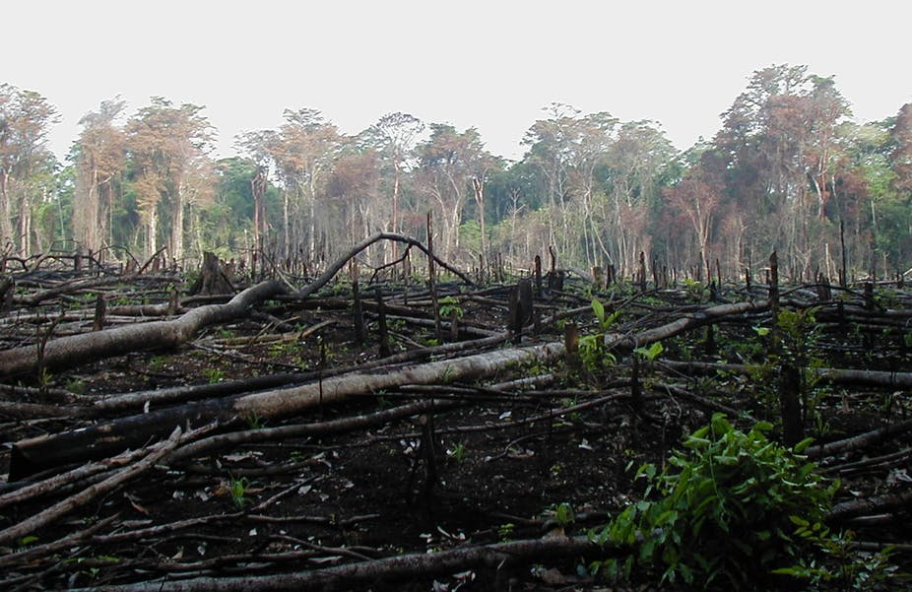
Humans dramatically affect land use
Deforestation of Borneo
Photo: Wikimedia Commons, Maps: UNEP

Slide 5
Maps of forest change at 30 m resolution
Hansen et al. (2013) Science
Notes:
In this panel we can probably all agree that biodiversity is one of the most valuable natural resources.
But things like climate change or habitat loss are a threat to biodiversity, to the extent that we hear about biodiversity crisis, or sixth mass extinction
For example, about 1% of vertebrate species have gone extinct because of humans

Slide 6
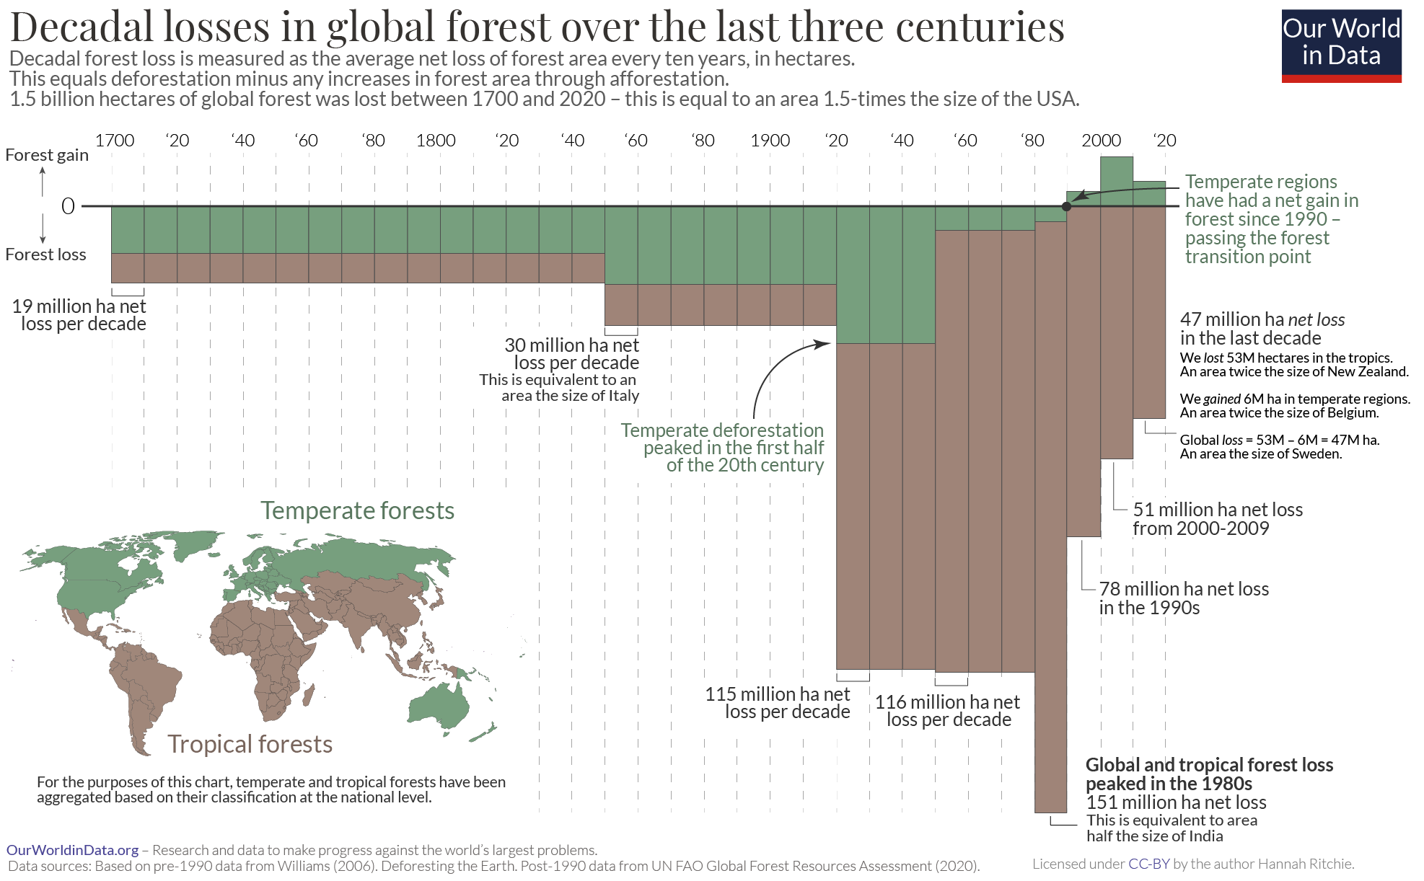
Global deforestation
Notes:
In this panel we can probably all agree that biodiversity is one of the most valuable natural resources.
But things like climate change or habitat loss are a threat to biodiversity, to the extent that we hear about biodiversity crisis, or sixth mass extinction
For example, about 1% of vertebrate species have gone extinct because of humans

Slide 7
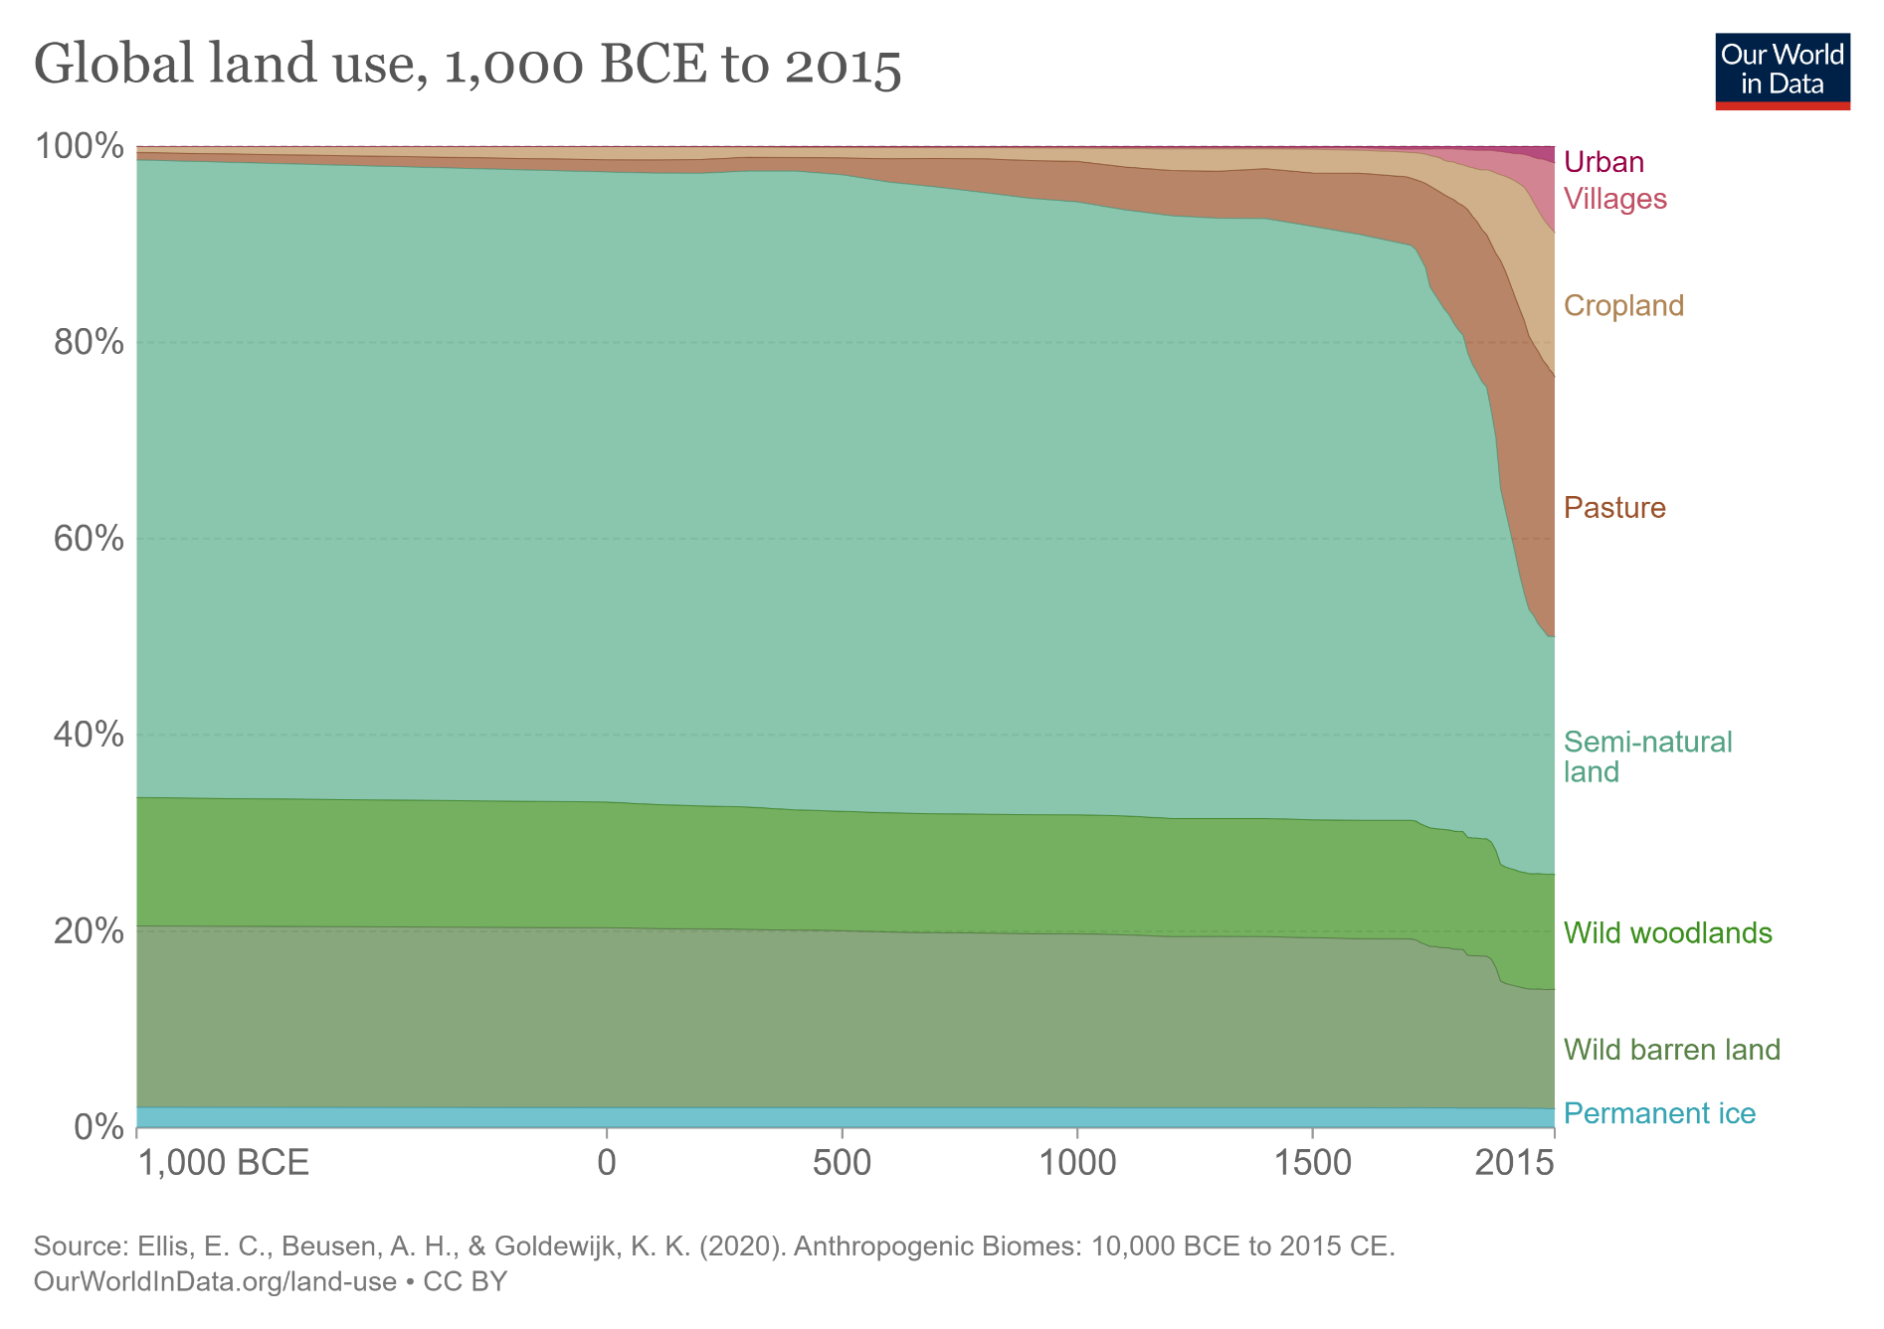
Global land use change
Notes:
In this panel we can probably all agree that biodiversity is one of the most valuable natural resources.
But things like climate change or habitat loss are a threat to biodiversity, to the extent that we hear about biodiversity crisis, or sixth mass extinction
For example, about 1% of vertebrate species have gone extinct because of humans

Slide 8
Effect of land use on species richness and abundance
Newbold et al. (2015) Nature
Notes:
In this panel we can probably all agree that biodiversity is one of the most valuable natural resources.
But things like climate change or habitat loss are a threat to biodiversity, to the extent that we hear about biodiversity crisis, or sixth mass extinction
For example, about 1% of vertebrate species have gone extinct because of humans

Slide 9
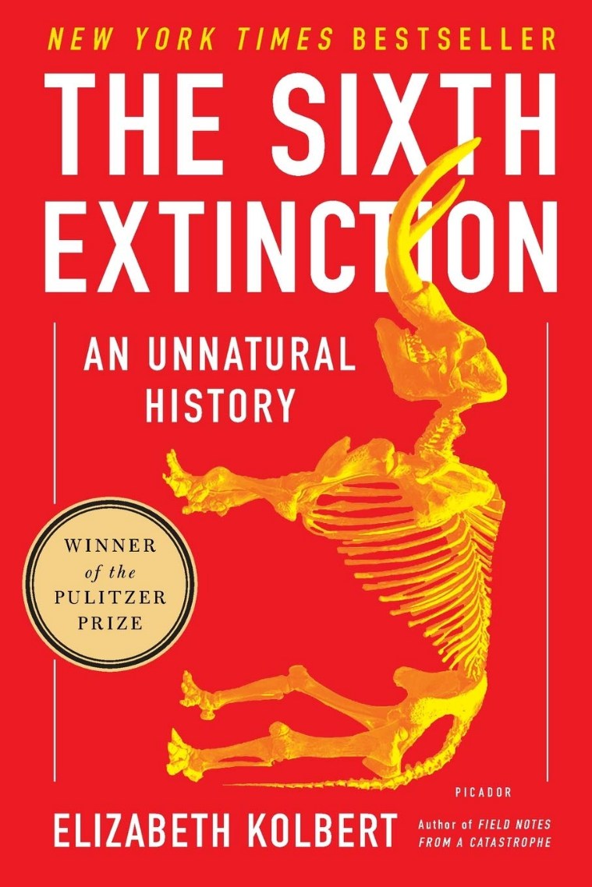
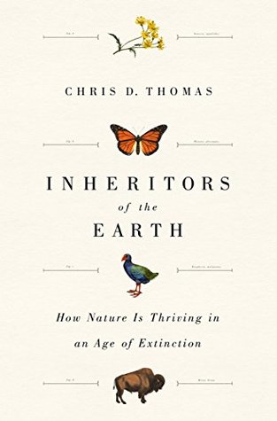
Given all the human-made pressures, are we in the midst of a biodiversity crisis?
IPBES (2019). Schiper et al. (2008) Science. Pereira et al. (2010) Science. Barnosky et al. (2012) Nature. Pimm et al. (2014) Science. Cowie et al. (2022) Biological Reviews.
Notes:
How are these environmental changes affecting biodiversity?
We often assume that the effect is negative, and we hear terms such as biodiversity crisis, or sixth mass extinction
For example, about 1% of known vertebrate species have gone extinct because of humans

Slide 10
Main review reports
How is biodiversity coping with all the environmental change?
What are its actual measured temporal trends?
Notes:
I am qualified to deliver all this

Slide 11
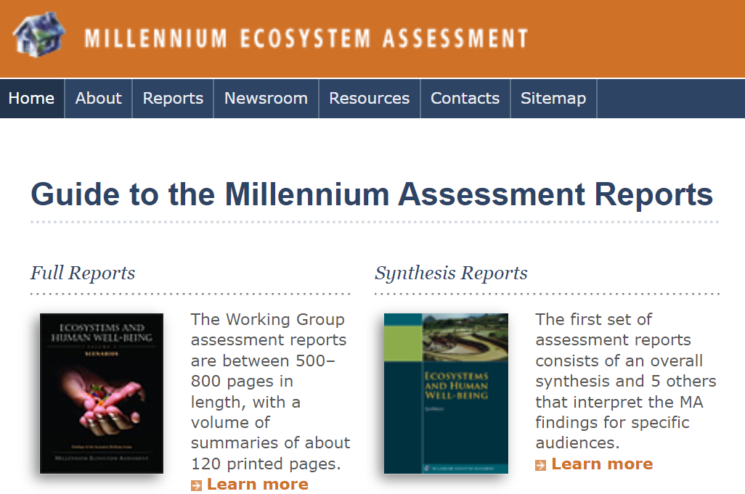
Millenium Ecosystem Assessment (2001-2005)
Notes:
In this panel we can probably all agree that biodiversity is one of the most valuable natural resources.
But things like climate change or habitat loss are a threat to biodiversity, to the extent that we hear about biodiversity crisis, or sixth mass extinction
For example, about 1% of vertebrate species have gone extinct because of humans

Slide 12
Global IPBES assessment (2010-present)
Inspired by IPCC (https://www.ipcc.ch/)
2010 - Initial impulse by United Nations General Assembly
2013 – first plenary initiated
2019, 2020, 2021 – the IBPES assessment report
IPBES (2019): Global assessment report on biodiversity and ecosystem services of the Intergovernmental Science-Policy Platform on Biodiversity and Ecosystem Services. E. S. Brondizio, J. Settele, S. Díaz, and H. T. Ngo (editors). IPBES secretariat, Bonn, Germany. 1148 pages. https://doi.org/10.5281/zenodo.3831673
IPBES (2019): Summary for policymakers of the global assessment report on biodiversity and ecosystem services of the Intergovernmental Science-Policy Platform on Biodiversity and Ecosystem Services. S. Díaz, J. Settele, E. S. Brondízio, H. T. Ngo, M. Guèze, J. Agard, A. Arneth, P. Balvanera, K. A. Brauman, S. H. M. Butchart, K. M. A. Chan, L. A. Garibaldi, K. Ichii, J. Liu, S. M. Subramanian, G. F. Midgley, P. Miloslavich, Z. Molnár, D. Obura, A. Pfaff, S. Polasky, A. Purvis, J. Razzaque, B. Reyers, R. Roy Chowdhury, Y. J. Shin, I. J. Visseren-Hamakers, K. J. Willis, and C. N. Zayas (eds.). IPBES secretariat, Bonn, Germany. 56 pages. https://doi.org/10.5281/zenodo.3553579
Notes:
In this panel we can probably all agree that biodiversity is one of the most valuable natural resources.
But things like climate change or habitat loss are a threat to biodiversity, to the extent that we hear about biodiversity crisis, or sixth mass extinction
For example, about 1% of vertebrate species have gone extinct because of humans

Slide 13
Example graphics from IPCC report: Global species loss
IPBES (2019)
Ceballos et a. (2015) Science Advances
Notes:
In this panel we can probably all agree that biodiversity is one of the most valuable natural resources.
But things like climate change or habitat loss are a threat to biodiversity, to the extent that we hear about biodiversity crisis, or sixth mass extinction
For example, about 1% of vertebrate species have gone extinct because of humans

Slide 14
Example graphics from IPCC report: Overall trends in simple accessible summary
IPBES (2019)
Notes:
In this panel we can probably all agree that biodiversity is one of the most valuable natural resources.
But things like climate change or habitat loss are a threat to biodiversity, to the extent that we hear about biodiversity crisis, or sixth mass extinction
For example, about 1% of vertebrate species have gone extinct because of humans

Slide 15
Living Planet Report 2022 – attempt to summarize populations trends
WWF & ZSL (2022)
https://livingplanet.panda.org/
Notes:
In this panel we can probably all agree that biodiversity is one of the most valuable natural resources.
But things like climate change or habitat loss are a threat to biodiversity, to the extent that we hear about biodiversity crisis, or sixth mass extinction
For example, about 1% of vertebrate species have gone extinct because of humans

Slide 16
Population changes
How have numbers of individuals, densities, or biomass been changing in the Anthropocene?
Notes:
I am qualified to deliver all this

Slide 17
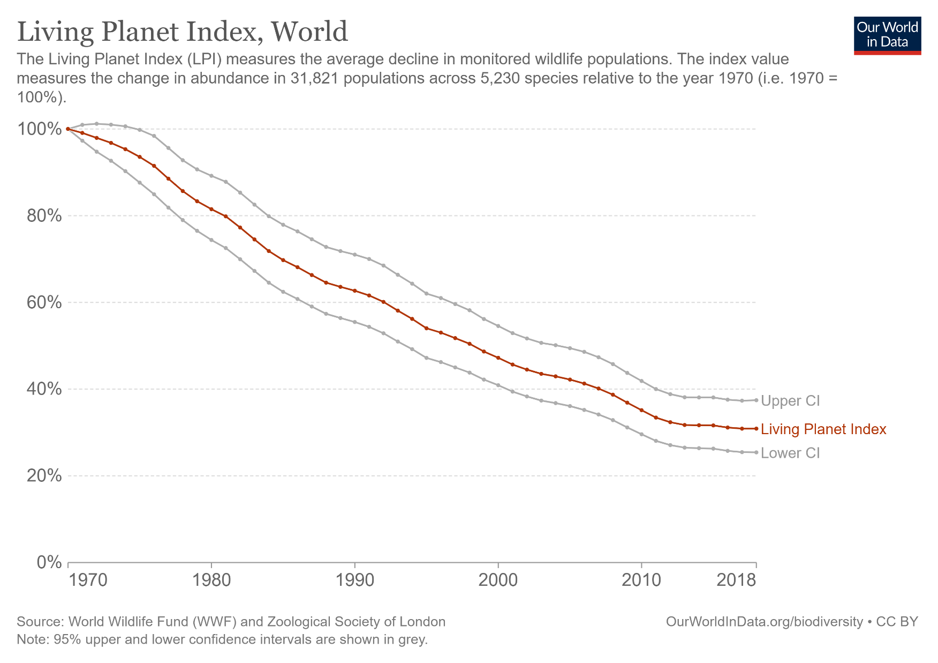
Living Planet Index (LPI) – summarizing all trends in a single average metric
WWF & ZSL (2022)
Notes:
In this panel we can probably all agree that biodiversity is one of the most valuable natural resources.
But things like climate change or habitat loss are a threat to biodiversity, to the extent that we hear about biodiversity crisis, or sixth mass extinction
For example, about 1% of vertebrate species have gone extinct because of humans

Slide 18
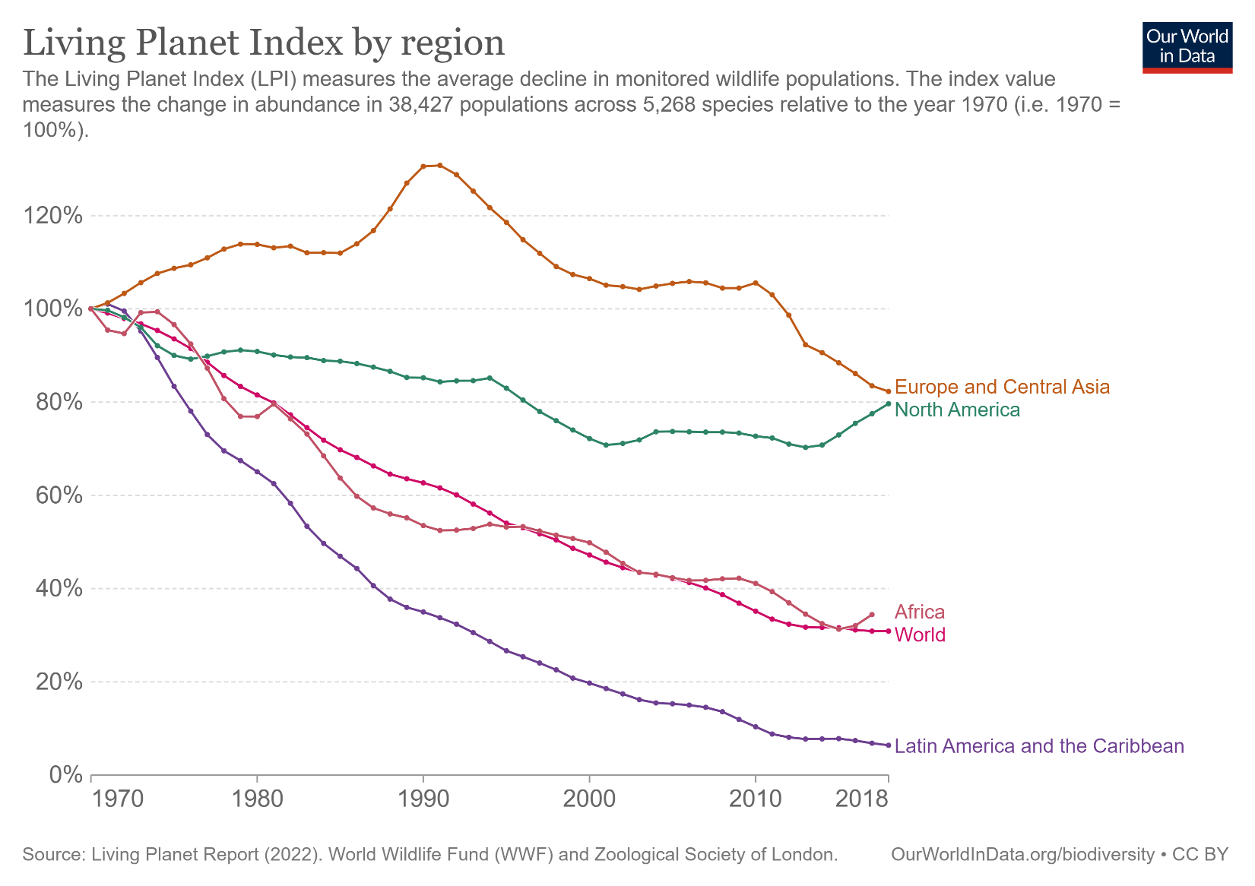
Living Planet Index (LPI) – decomposing the metric by continents
WWF & ZSL (2022)
Notes:
In this panel we can probably all agree that biodiversity is one of the most valuable natural resources.
But things like climate change or habitat loss are a threat to biodiversity, to the extent that we hear about biodiversity crisis, or sixth mass extinction
For example, about 1% of vertebrate species have gone extinct because of humans

Slide 19
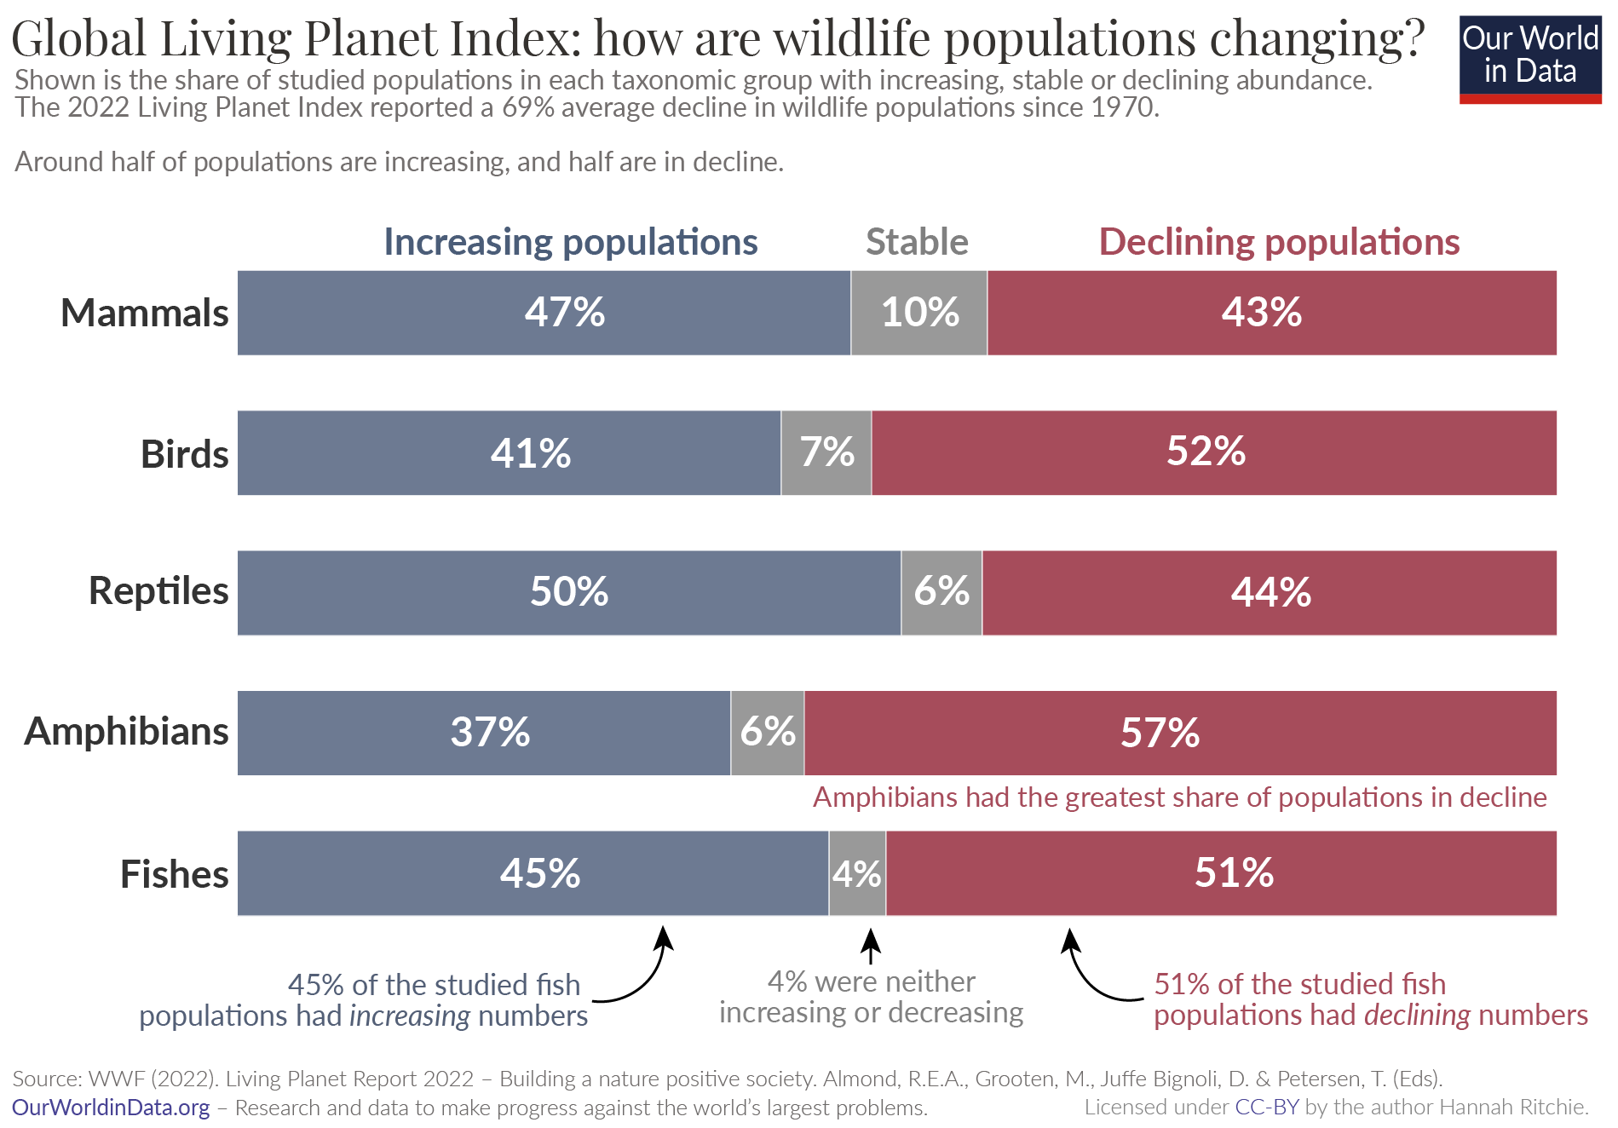
Living Planet Index (LPI) – decomposing the trends by major vertebrate taxa
WWF & ZSL (2022)
Notes:
In this panel we can probably all agree that biodiversity is one of the most valuable natural resources.
But things like climate change or habitat loss are a threat to biodiversity, to the extent that we hear about biodiversity crisis, or sixth mass extinction
For example, about 1% of vertebrate species have gone extinct because of humans

Slide 20
But there has been a lively debate in Nature on the relevance of LPI
Notes:
In this panel we can probably all agree that biodiversity is one of the most valuable natural resources.
But things like climate change or habitat loss are a threat to biodiversity, to the extent that we hear about biodiversity crisis, or sixth mass extinction
For example, about 1% of vertebrate species have gone extinct because of humans

Slide 21
Leung et al. (2020) argue that the decline is driven by less than 3% of populations
Leung et al. (2020) Nature
Notes:
In this panel we can probably all agree that biodiversity is one of the most valuable natural resources.
But things like climate change or habitat loss are a threat to biodiversity, to the extent that we hear about biodiversity crisis, or sixth mass extinction
For example, about 1% of vertebrate species have gone extinct because of humans

Slide 22
The complex geography of population trends
Terrestrial populations
Marine populations
Freshwater populations
Leung et al. (2020) Nature
Notes:
In this panel we can probably all agree that biodiversity is one of the most valuable natural resources.
But things like climate change or habitat loss are a threat to biodiversity, to the extent that we hear about biodiversity crisis, or sixth mass extinction
For example, about 1% of vertebrate species have gone extinct because of humans

Slide 23
An illustrative story of Czech birds
Forest birds
We observe decreases of population indices in farmland birds, but increases in forest birds
Reif et al. (2007) Bird Study
Reif & Vermouzek (2019) Conservation Letters
Notes:
In this panel we can probably all agree that biodiversity is one of the most valuable natural resources.
But things like climate change or habitat loss are a threat to biodiversity, to the extent that we hear about biodiversity crisis, or sixth mass extinction
For example, about 1% of vertebrate species have gone extinct because of humans

Slide 24
Insect armagedon
Notes:
I am qualified to deliver all this

Slide 25
The paper that started it all …
Hallmann et al. (2017) PLOS One
Notes:
- But it is not as simple.
- There have been studies looking at thousands of time series from local communities. Surprisingly, on average, we see no net change of species richness.
- So we have global extinctions, but no decline of local biodiversity?
- How is that possible?
First, there are sampling issues and a lack of local data in most regions, which can cause the mismatch between local and global
Second, different studies use different metrics. For example, decline of species richness is not the same as extinction

Slide 26
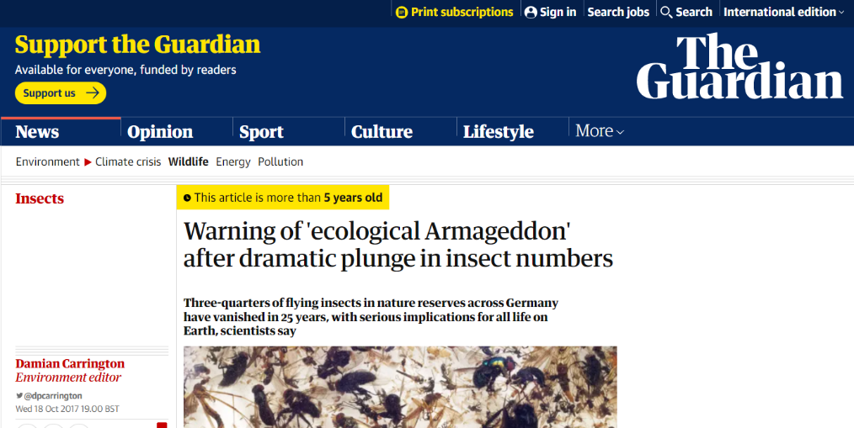
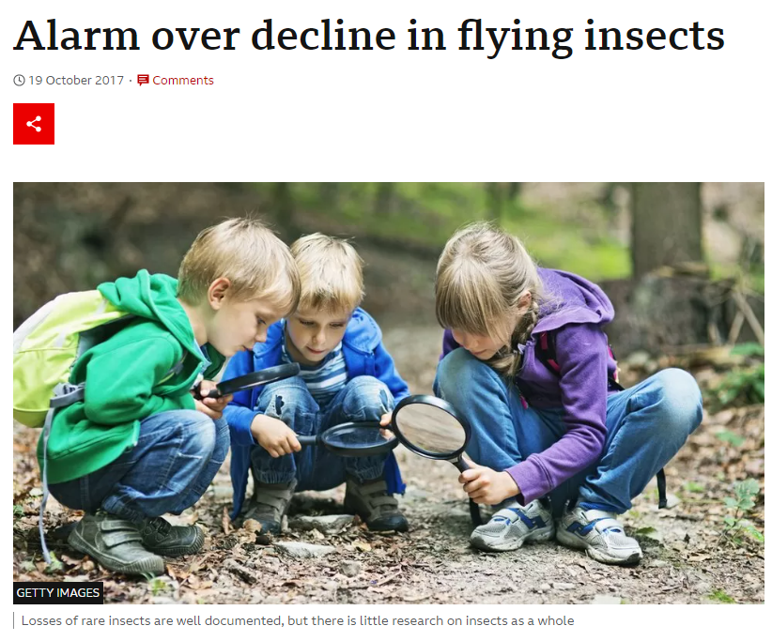

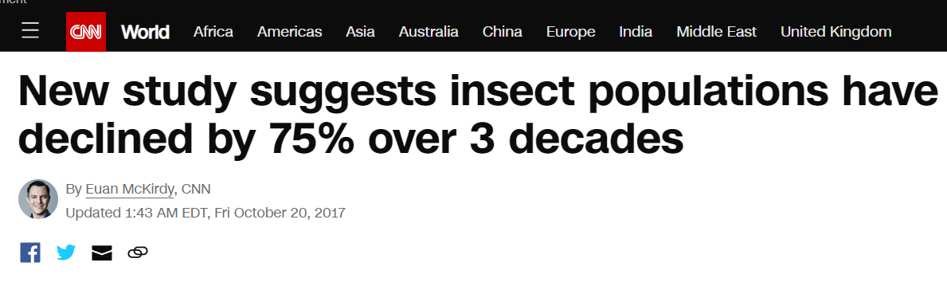
… and the reaction in media
Hallmann et al. (2017) PLOS One
Notes:
- But it is not as simple.
- There have been studies looking at thousands of time series from local communities. Surprisingly, on average, we see no net change of species richness.
- So we have global extinctions, but no decline of local biodiversity?
- How is that possible?
First, there are sampling issues and a lack of local data in most regions, which can cause the mismatch between local and global
Second, different studies use different metrics. For example, decline of species richness is not the same as extinction

Slide 27
Malaise traps in 63 nature protection areas in Germany
Hallmann et al. (2017) PLOS One
Notes:
- But it is not as simple.
- There have been studies looking at thousands of time series from local communities. Surprisingly, on average, we see no net change of species richness.
- So we have global extinctions, but no decline of local biodiversity?
- How is that possible?
First, there are sampling issues and a lack of local data in most regions, which can cause the mismatch between local and global
Second, different studies use different metrics. For example, decline of species richness is not the same as extinction

Slide 28
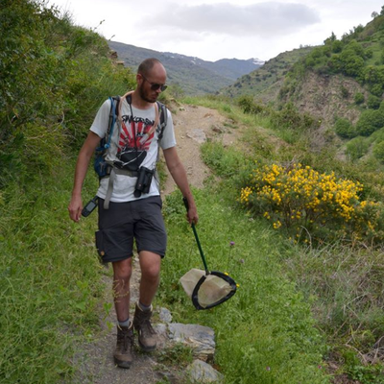
Roel van Klink’s response: Analysis of1676 sites globally
van Klink et al. (2020) Science
Notes:
- But it is not as simple.
- There have been studies looking at thousands of time series from local communities. Surprisingly, on average, we see no net change of species richness.
- So we have global extinctions, but no decline of local biodiversity?
- How is that possible?
First, there are sampling issues and a lack of local data in most regions, which can cause the mismatch between local and global
Second, different studies use different metrics. For example, decline of species richness is not the same as extinction

Slide 29
Roel van Klink’s response: Analysis of1676 sites globally
Van Klink et al. (2020) Science
Notes:
- But it is not as simple.
- There have been studies looking at thousands of time series from local communities. Surprisingly, on average, we see no net change of species richness.
- So we have global extinctions, but no decline of local biodiversity?
- How is that possible?
First, there are sampling issues and a lack of local data in most regions, which can cause the mismatch between local and global
Second, different studies use different metrics. For example, decline of species richness is not the same as extinction

Slide 30
Species richness change
Mostly in local communities – why it seems to be on average 0, and what it means.
Notes:
I am qualified to deliver all this

Slide 31
No net decline of species richness in local plant communities
Vellend et al. (2013) PNAS
Notes:
- But it is not as simple.
- There have been studies looking at thousands of time series from local communities. Surprisingly, on average, we see no net change of species richness.
- So we have global extinctions, but no decline of local biodiversity?
- How is that possible?
First, there are sampling issues and a lack of local data in most regions, which can cause the mismatch between local and global
Second, different studies use different metrics. For example, decline of species richness is not the same as extinction

Slide 32
No net decline of species richness in local plant communities
Vellend et al. (2013) PNAS
Notes:
- But it is not as simple.
- There have been studies looking at thousands of time series from local communities. Surprisingly, on average, we see no net change of species richness.
- So we have global extinctions, but no decline of local biodiversity?
- How is that possible?
First, there are sampling issues and a lack of local data in most regions, which can cause the mismatch between local and global
Second, different studies use different metrics. For example, decline of species richness is not the same as extinction

Slide 33
No net decline of species richness in local plant communities
Jandt et al. (2022) Nature
Notes:
- But it is not as simple.
- There have been studies looking at thousands of time series from local communities. Surprisingly, on average, we see no net change of species richness.
- So we have global extinctions, but no decline of local biodiversity?
- How is that possible?
First, there are sampling issues and a lack of local data in most regions, which can cause the mismatch between local and global
Second, different studies use different metrics. For example, decline of species richness is not the same as extinction

Slide 34
No net decline of species richness in local communities
Dornelas et al. (2015) Science, Dornelas et al. (2017) GEB
Notes:
- But it is not as simple.
- There have been studies looking at thousands of time series from local communities. Surprisingly, on average, we see no net change of species richness.
- So we have global extinctions, but no decline of local biodiversity?
- How is that possible?
First, there are sampling issues and a lack of local data in most regions, which can cause the mismatch between local and global
Second, different studies use different metrics. For example, decline of species richness is not the same as extinction

Slide 35
No net decline of species richness in local communities
Dornelas et al. (2014) Science, Dornelas et al. (2017) GEB
Notes:
- But it is not as simple.
- There have been studies looking at thousands of time series from local communities. Surprisingly, on average, we see no net change of species richness.
- So we have global extinctions, but no decline of local biodiversity?
- How is that possible?
First, there are sampling issues and a lack of local data in most regions, which can cause the mismatch between local and global
Second, different studies use different metrics. For example, decline of species richness is not the same as extinction

Slide 36
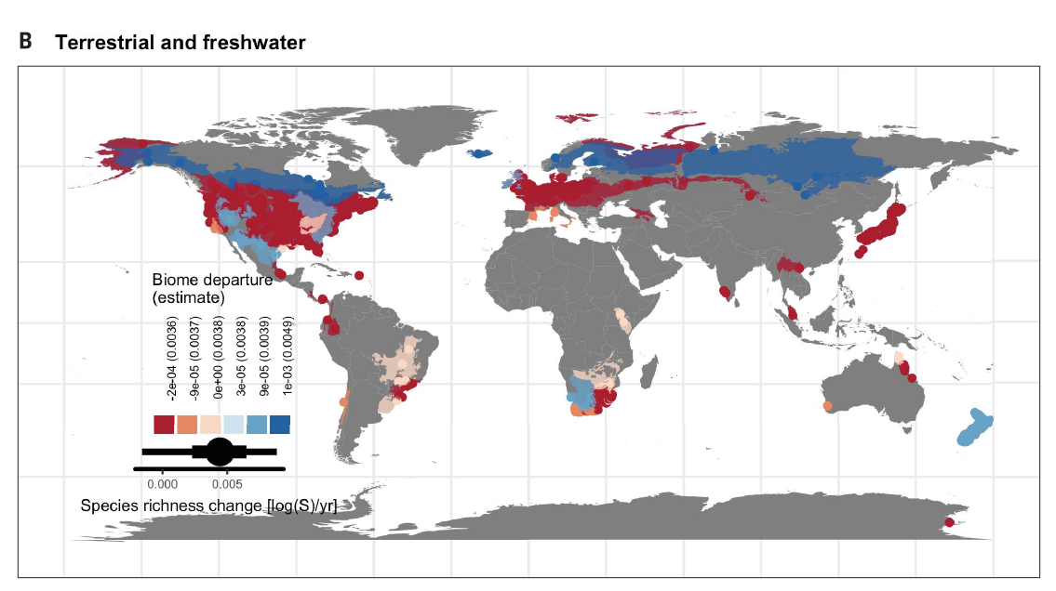
No net decline of species richness in local communities
Blowes et al. (2019) Science
Notes:
- But it is not as simple.
- There have been studies looking at thousands of time series from local communities. Surprisingly, on average, we see no net change of species richness.
- So we have global extinctions, but no decline of local biodiversity?
- How is that possible?
First, there are sampling issues and a lack of local data in most regions, which can cause the mismatch between local and global
Second, different studies use different metrics. For example, decline of species richness is not the same as extinction

Slide 37
Why no change of local richness, if we think that things should be going bad?
The problem of shifting baselines – maybe things were already bad at the start of the time series, and so we are not seeing the main change because it happened long ago
We are sampling only the nice and pristine locations, not parking lots and industrial areas
There is massive geographic bias towards the rich Global North, accessible areas, etc.
We fail to detect the loss of rare species, because they are … rare
The problem of spatial grain
Notes:
- But it is not as simple.
- There have been studies looking at thousands of time series from local communities. Surprisingly, on average, we see no net change of species richness.
- So we have global extinctions, but no decline of local biodiversity?
- How is that possible?
First, there are sampling issues and a lack of local data in most regions, which can cause the mismatch between local and global
Second, different studies use different metrics. For example, decline of species richness is not the same as extinction

Slide 38
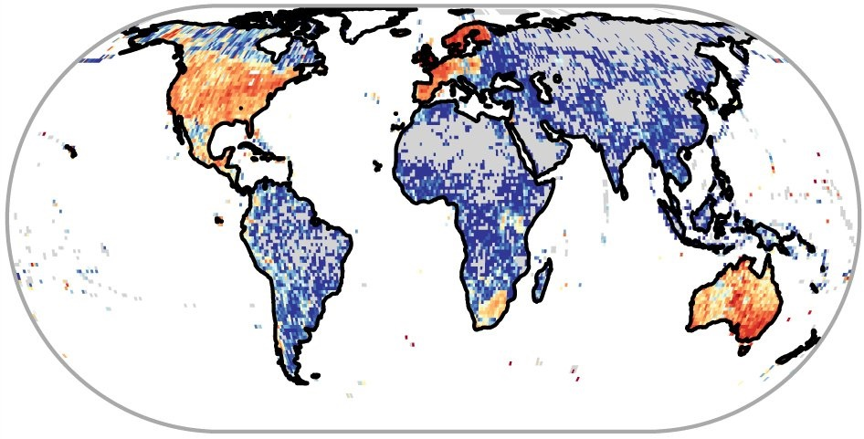
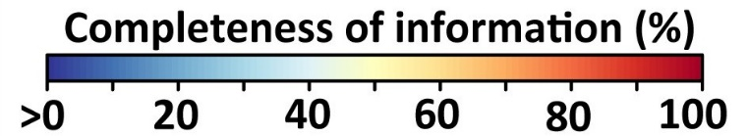
Sampling problem - Gaps and biases in biodiversity data
Meyer et al. (2015) Nature Communications

Slide 39
Sampling problem - Gaps and biases in biodiversity data
Dornelas et al. (2015) Science, Dornelas et al. (2017) GEB
Notes:
- But it is not as simple.
- There have been studies looking at thousands of time series from local communities. Surprisingly, on average, we see no net change of species richness.
- So we have global extinctions, but no decline of local biodiversity?
- How is that possible?
First, there are sampling issues and a lack of local data in most regions, which can cause the mismatch between local and global
Second, different studies use different metrics. For example, decline of species richness is not the same as extinction

Slide 40
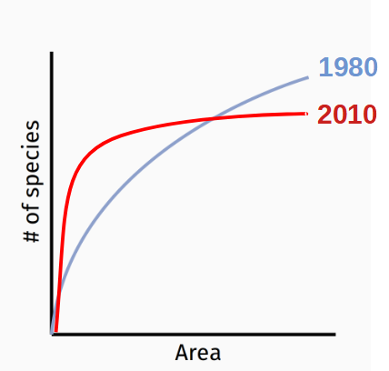

Scale problem - Biodiversity change is grain dependent
decrease
increase
Keil et al. (2011) Ecography
Powell et al. (2013) Science
Notes:
In this panel we can probably all agree that biodiversity is one of the most valuable natural resources.
But things like climate change or habitat loss are a threat to biodiversity, to the extent that we hear about biodiversity crisis, or sixth mass extinction
For example, about 1% of vertebrate species have gone extinct because of humans

Slide 41
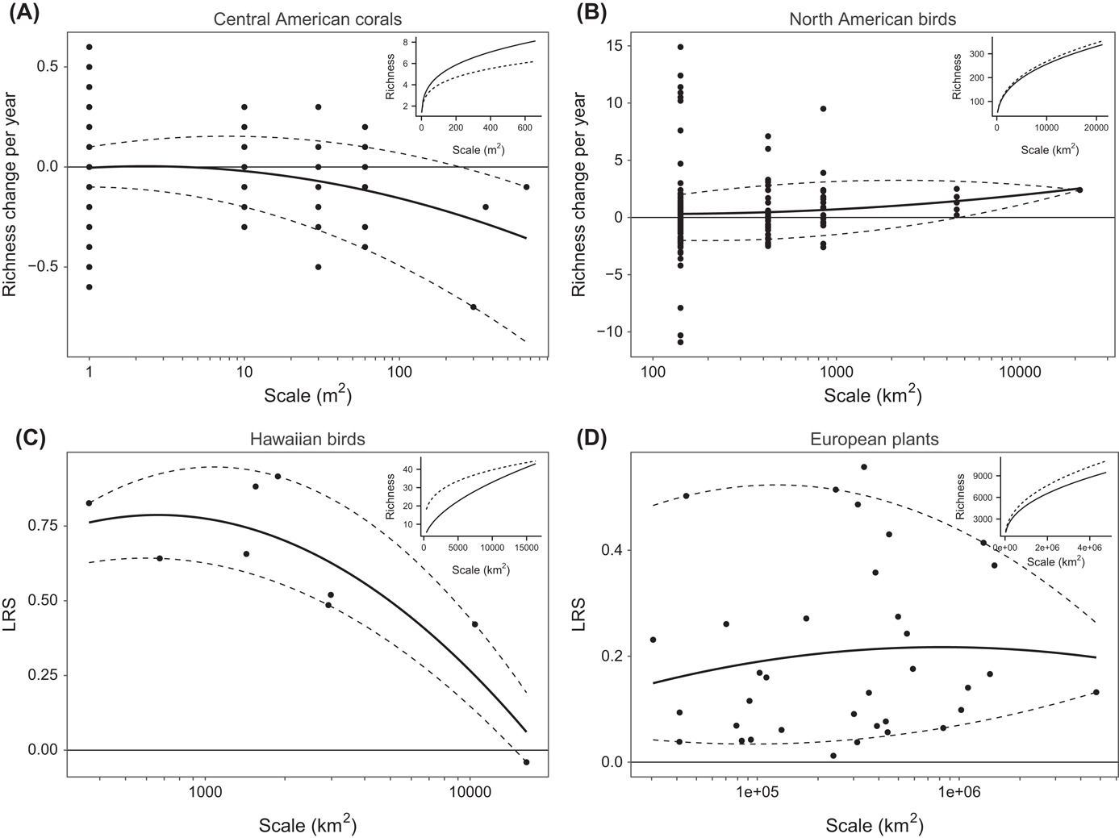
Scale problem - Biodiversity change is grain dependent
Chase et al. (2019) Oikos
Notes:
In this panel we can probably all agree that biodiversity is one of the most valuable natural resources.
But things like climate change or habitat loss are a threat to biodiversity, to the extent that we hear about biodiversity crisis, or sixth mass extinction
For example, about 1% of vertebrate species have gone extinct because of humans

Slide 42

Scale problem - Biodiversity change is grain dependent
Leroy (2022) EcoEvoRxiv
Notes:
In this panel we can probably all agree that biodiversity is one of the most valuable natural resources.
But things like climate change or habitat loss are a threat to biodiversity, to the extent that we hear about biodiversity crisis, or sixth mass extinction
For example, about 1% of vertebrate species have gone extinct because of humans

Slide 43
Scale problem - Biodiversity change is grain dependent
Leroy (2022) EcoEvoRxiv
Notes:
In this panel we can probably all agree that biodiversity is one of the most valuable natural resources.
But things like climate change or habitat loss are a threat to biodiversity, to the extent that we hear about biodiversity crisis, or sixth mass extinction
For example, about 1% of vertebrate species have gone extinct because of humans

Slide 44
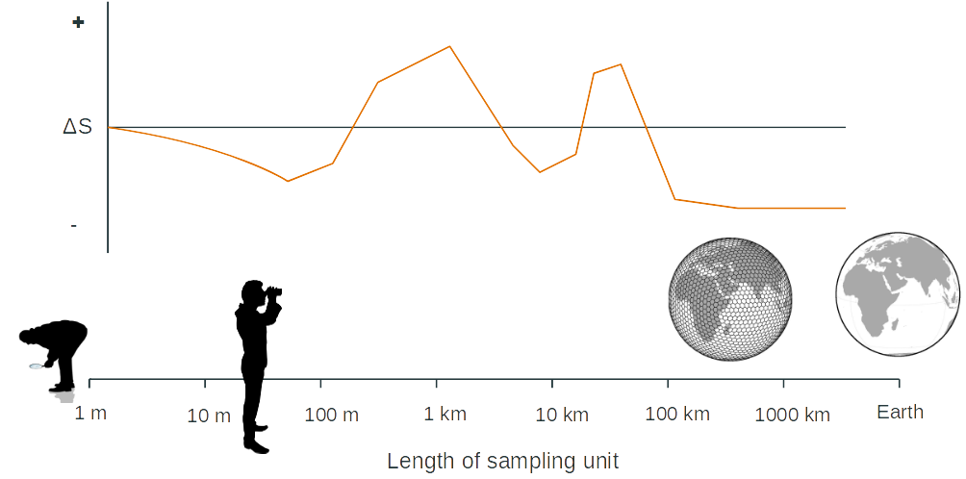
Scale problem - Biodiversity change is grain dependent
This is a hypothetical toy example of how variable can species richness change be with scale, reality is probably not like that …
Notes:
In this panel we can probably all agree that biodiversity is one of the most valuable natural resources.
But things like climate change or habitat loss are a threat to biodiversity, to the extent that we hear about biodiversity crisis, or sixth mass extinction
For example, about 1% of vertebrate species have gone extinct because of humans

Slide 45
Change of species composition
Why no net change of species richness can still mean substantial changes
Notes:
I am qualified to deliver all this

Slide 46
Even if richness is stable, composition changes
Dornelas et al. (2014) Science, Dornelas et al. (2017) GEB
Notes:
- But it is not as simple.
- There have been studies looking at thousands of time series from local communities. Surprisingly, on average, we see no net change of species richness.
- So we have global extinctions, but no decline of local biodiversity?
- How is that possible?
First, there are sampling issues and a lack of local data in most regions, which can cause the mismatch between local and global
Second, different studies use different metrics. For example, decline of species richness is not the same as extinction

Slide 47
Biotic homogenization despite increasing or stable richness
Low beta diversity
High beta diversity
Homogenization
Low beta diversity
Differentiation
Notes:
In this panel we can probably all agree that biodiversity is one of the most valuable natural resources.
But things like climate change or habitat loss are a threat to biodiversity, to the extent that we hear about biodiversity crisis, or sixth mass extinction
For example, about 1% of vertebrate species have gone extinct because of humans

Slide 48

Species spreads, invasions, and extinctions as the driving force of homogenization
Low beta diversity
High beta diversity
Homogenization
Low beta diversity
Differentiation
Notes:
In this panel we can probably all agree that biodiversity is one of the most valuable natural resources.
But things like climate change or habitat loss are a threat to biodiversity, to the extent that we hear about biodiversity crisis, or sixth mass extinction
For example, about 1% of vertebrate species have gone extinct because of humans

Slide 49
Species spreads, invasions, and extinctions as the driving force of homogenization
Winter et al. (2009) PNAS
Notes:
In this panel we can probably all agree that biodiversity is one of the most valuable natural resources.
But things like climate change or habitat loss are a threat to biodiversity, to the extent that we hear about biodiversity crisis, or sixth mass extinction
For example, about 1% of vertebrate species have gone extinct because of humans

Slide 50
But let’s wait for what others will say – Blowes et al. have something in the oven
Blowes et al. (2022) bioRxiv
Notes:
In this panel we can probably all agree that biodiversity is one of the most valuable natural resources.
But things like climate change or habitat loss are a threat to biodiversity, to the extent that we hear about biodiversity crisis, or sixth mass extinction
For example, about 1% of vertebrate species have gone extinct because of humans

Slide 51
Summary

Slide 52
The big picture
We know that with growing human population, the pressure on nature increases.
Climate changes, land use changes, populations and ecosystems are exploited
Yet the empirical data tell a nuanced and complex story. Population abundances and species richness show variable temporal trends, there is a lot of local context, and although more areas deteriorate, other areas improve, or the good/bad of the trend cannot be clearly identified
Also, composition changes considerably, irrespectively to diversity changes, and there is both homogeneization and differentiation
How is that possible?
Likely due to complex nature of the drivers, but also the data are geographically, taxonomically, and environmentally biased.
Notes:
- But it is not as simple.
- There have been studies looking at thousands of time series from local communities. Surprisingly, on average, we see no net change of species richness.
- So we have global extinctions, but no decline of local biodiversity?
- How is that possible?
First, there are sampling issues and a lack of local data in most regions, which can cause the mismatch between local and global
Second, different studies use different metrics. For example, decline of species richness is not the same as extinction

Slide 53
Thank you. Questions?

Slide 54
So many additional interesting stories there …
Dirzo et al. (2014) Science
Notes:
- But it is not as simple.
- There have been studies looking at thousands of time series from local communities. Surprisingly, on average, we see no net change of species richness.
- So we have global extinctions, but no decline of local biodiversity?
- How is that possible?
First, there are sampling issues and a lack of local data in most regions, which can cause the mismatch between local and global
Second, different studies use different metrics. For example, decline of species richness is not the same as extinction

Slide 55
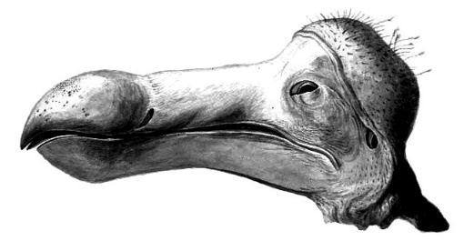
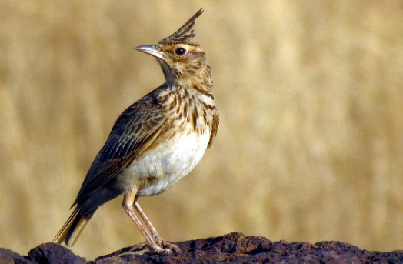
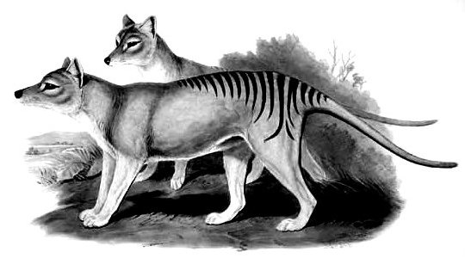
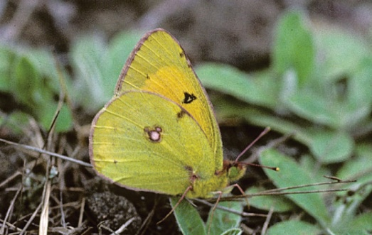
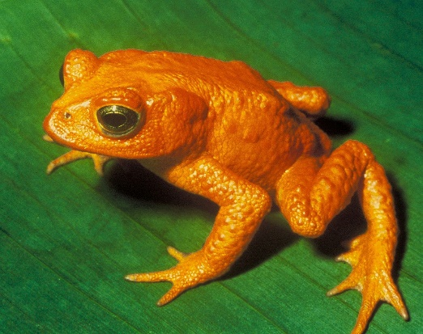
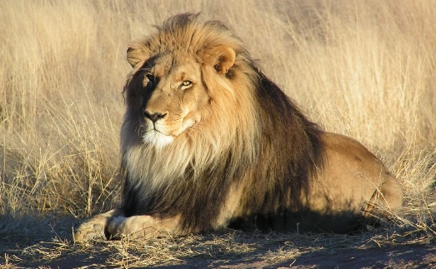
Focusing on a single scale misses the whole picture
Global extinctions
Regional and local extinctions
The dodo †1963
Crested lark
Tasmanian tiger †1936
Danube clouded yellow
Golden toad †1989
Lion
Ceballos et al. (2017) PNAS. Images: Wikimedia commons

Slide 56
Biodiversity change is scale-dependent
Keil et al. (2018) Global Ecology and Biogeography

Slide 57
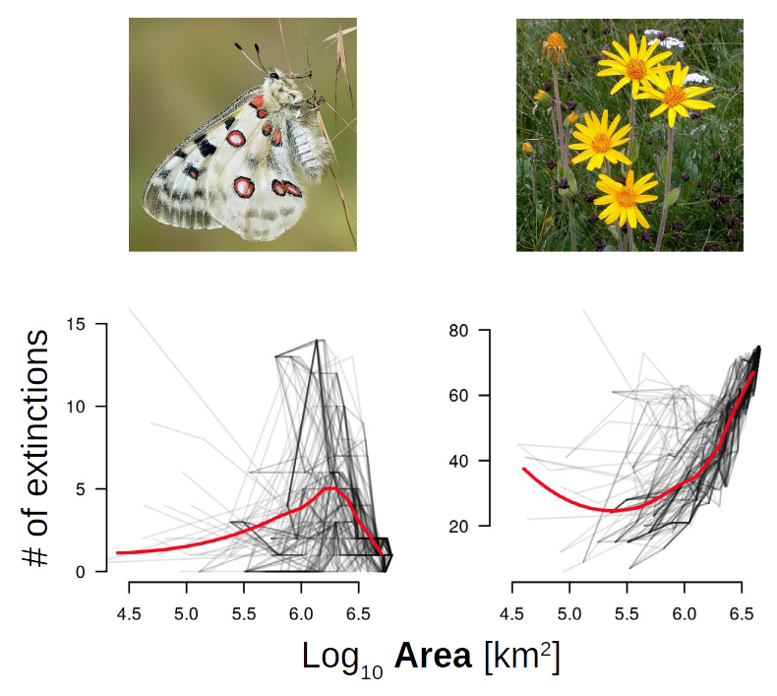
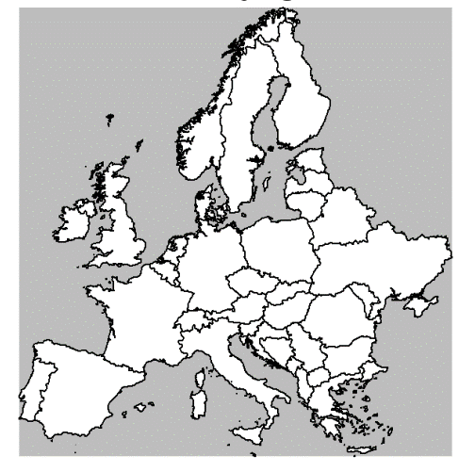
Biodiversity change is scale-dependent
Keil et al. (2018) Global Ecology and Biogeography

